Slide 1


AI-Powered Stroke Risk
Forecast

Slide 2

01 02 03 04 05
06
Stroke & Data Landscape
Model Blueprint Validation & Ethics Clinical Deployment Impact & Next Steps Takeaways

Slide 3

01
Stroke & Data Landscape

Slide 4

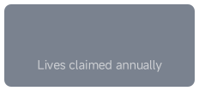
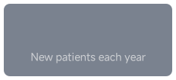

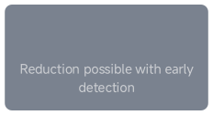
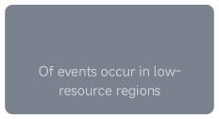

6.5M
30%
12M
80%
The Silent Global Burden of Stroke

Slide 5

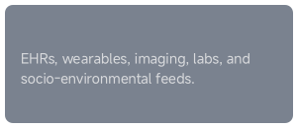
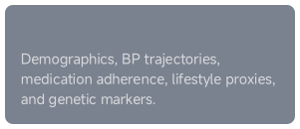
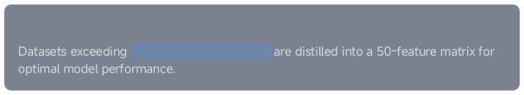
Clinical Data Goldmine Unpacked
Data Sources
Key Predictors
Scale & Granularity
300variables per patient

Slide 6
02
Model Blueprint

Slide 7






From EHR to Model Matrix: The Data Pipeline
Raw EHR Data
Pro cessi ng
Feature Matrix
granularity with computational tractability

Slide 8
Algorithm Lineup & Performance
Model
Logistic Regression
Cross-Validated AUC
0.78
Key Strengths
Interpretable baseline
Random Forest
0.85
Captures non-linear interactions
XGBoost
0.91
Superior performance on BP-lipid interactions
RNN
0.88
Exploits temporal visit sequences
1.2 million patient records

Slide 9
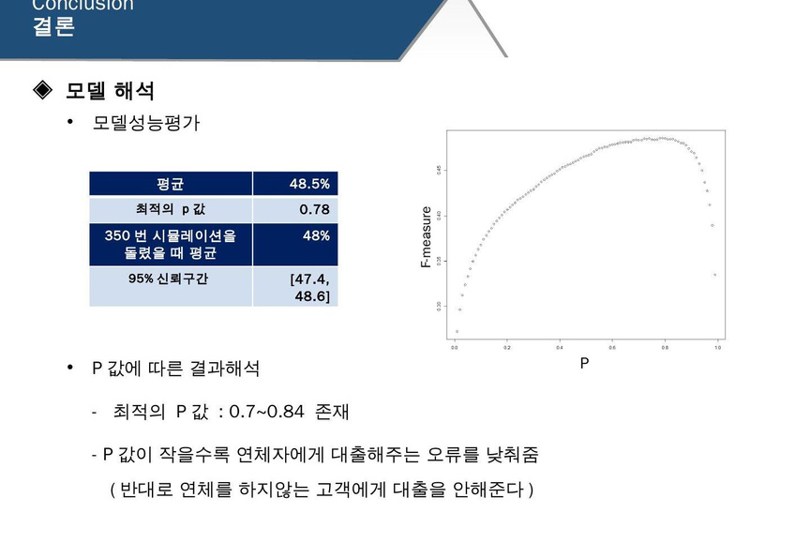


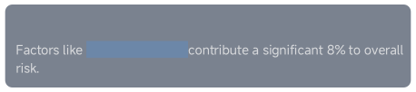
Feature Influence Decoded
Top Clinical Drivers
Lifestyle Contribution
sleep irregularity

Slide 10
03
Validation & Ethics

Slide 11


External Validation: The Reality Check
0.91
Initial Performance Drop
Key Findings & Actions
Under-prediction in African ancestry cohorts linked to genetic and
socio-economic datagaps.
0.85
Addressedvia site-specific retraining and fairness-constrained
objectives.
Model was successfully calibrated using Platt scaling for reliable probability estimates.

Slide 12



Bias Mitigation Playbook
18%
4%
Mitigation Strategies
A dedicated governance committee mandatescontinuousmonitoringtoensure the model supports health equity and
does not widen existing disparities.

Slide 13
04
Clinical Deployment

Slide 14
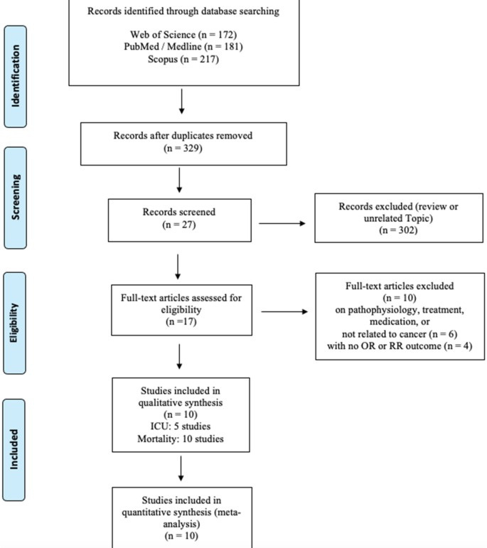




Real-Time CDS Integration
200ms Response Time
Actionable Alerts
Auto-Documentation

Slide 15
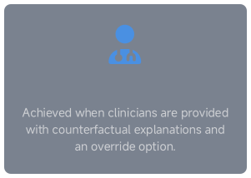
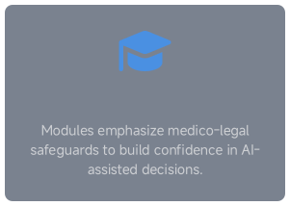
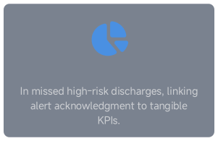
Driving Frontline Adoption
78% Trust Rate
Training & Safeguards
15% Reduction

Slide 16
05
Impact& Next Steps

Slide 17


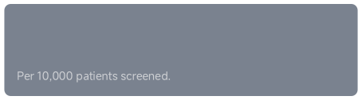

Outcome & ROI Evidence
92
StrokesPrevented
$4.1M
Cost Savings

Slide 18




Future Model Roadmap: Towards Precision Prevention
M ul ti -O m ics
Wearable Data
Social Determinants
Federated Learning
reactive alerts to proactive, personalized prevention

Slide 19
06
Takeaways

Slide 20
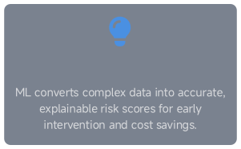
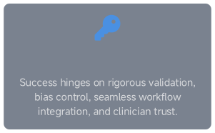
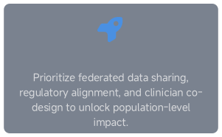
Actionable Insights Summary
The Value Proposition
The Success Factors
The Path Forward

Slide 21

THANK
YOU
DONE BY
KUNDOOR ANURAG REDDY (2403A54071)
NAYINI KALYAN REDDY (2403A54074
PUSALA SATHWIK (2403A54075)

